Slide 1

Copyright © 2012 Addison-Wesley. All rights reserved.

Slide 2
Lecture 9
CS4080
Concurrency (Chapter 13)

Slide 3
Outline
Introduction
Subprogram-Level Concurrency
Semaphores
Monitors
Message Passing
Ada Support for Concurrency
Java Threads
C# Threads

Slide 4
Introduction
Concurrency can occur at four levels:
Machine instruction level
High-level language statement level
Unit level
Program level
Because there are no language issues in instruction- and program-level concurrency, they are not addressed here

Slide 5
Categories of Concurrency
A thread of control in a program is the sequence of program points reached as control flows through the program
Categories of Concurrency:
Physical concurrency - Multiple independent processors ( multiple threads of control)
Logical concurrency - The appearance of physical concurrency is presented by time-sharing one processor (software can be designed as if there were multiple threads of control)

Slide 6
Subprogram-Level Concurrency
A task or process is a program unit that can be in concurrent execution with other program units
Tasks differ from ordinary subprograms in that:
A task may be implicitly started
When a program unit starts the execution of a task, it is not necessarily suspended
When a task’s execution is completed, control may not return to the caller

Slide 7
Two General Categories of Tasks
Heavyweight tasks execute in their own address space
Lightweight tasks all run in the same address space – more efficient
A task is disjoint if it does not communicate with or affect the execution of any other task in the program in any way
Heavyweight tasks execute in their own address space
Lightweight tasks all run in the same address space – more efficient
A task is disjoint if it does not communicate with or affect the execution of any other task in the program in any way

Slide 8
Task synchronization
Cooperation: Task A must wait for task B to complete some specific activity before task A can continue its execution
e.g., the producer-consumer problem
Competition: Two or more tasks must use some resource that cannot be simultaneously used
e.g., a shared counter
Methods of Providing Synchronization
Semaphores
Monitors
Message Passing

Slide 9
Semaphores
Dijkstra - 1965
A semaphore is a data structure consisting of a counter and a queue for storing task descriptors
Semaphores can be used to implement guards on the code that accesses shared data structures
Semaphores have only two operations, wait and release (originally called P and V by Dijkstra)
Semaphores can be used to provide both competition and cooperation synchronization

Slide 10
Semaphores: wait operation
wait(aSemaphore)
if aSemaphore’s counter > 0 then
decrement aSemaphore’s counter
else
put the caller in aSemaphore’s queue
attempt to transfer control to a ready task
-- if the task ready queue is empty,
-- deadlock occurs
end

Slide 11
Semaphores: Release Operation
release(aSemaphore)
if aSemaphore’s queue is empty then
increment aSemaphore’s counter
else
put the calling task in the task ready queue
transfer control to a task from aSemaphore’s queue
end

Slide 12
Producer Code
semaphore fullspots, emptyspots;
fullstops.count = 0;
emptyspots.count = BUFLEN;
task producer;
loop
-- produce VALUE –-
wait (emptyspots); {wait for space}
DEPOSIT(VALUE);
release(fullspots); {increase filled}
end loop;
end producer;

Slide 13
Consumer Code
task consumer;
loop
wait (fullspots);{wait till not empty}}
FETCH(VALUE);
release(emptyspots); {increase empty}
-- consume VALUE –-
end loop;
end consumer;

Slide 14
Evaluation of Semaphores
Misuse of semaphores can cause failures in cooperation synchronization, e.g., the buffer will overflow if the wait of fullspots is left out
Misuse of semaphores can cause failures in competition synchronization, e.g., the program will deadlock if the release of access is left out

Slide 15
Monitors
Ada, Java, C#
The idea: encapsulate the shared data and its operations to restrict access
A monitor is an abstract data type for shared data

Slide 16
Competition Synchronization
Shared data is resident in the monitor (rather than in the client units)
All access resident in the monitor
Monitor implementation guarantee synchronized access by allowing only one access at a time
Calls to monitor procedures are implicitly queued if the monitor is busy at the time of the call

Slide 17
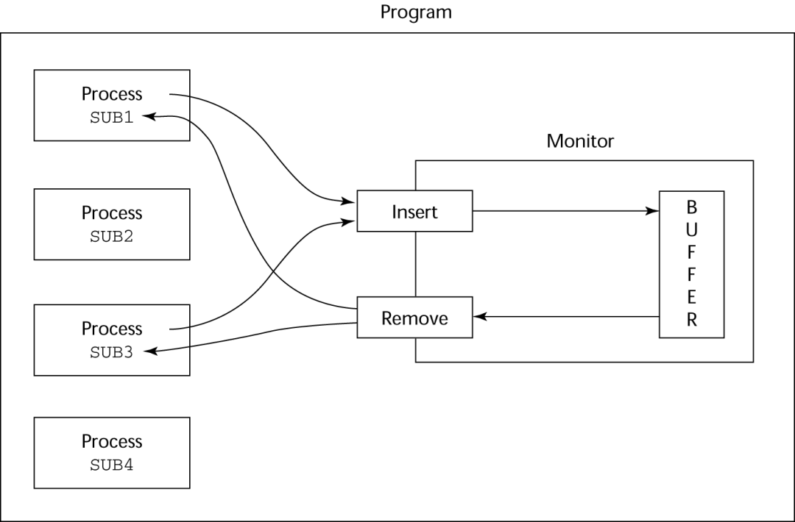
Cooperation Synchronization
Cooperation between processes is still a programming task
Programmer must guarantee that a shared buffer does not experience underflow or overflow

Slide 18
Evaluation of Monitors
A better way to provide competition synchronization than are semaphores
Semaphores can be used to implement monitors
Monitors can be used to implement semaphores
Support for cooperation synchronization is very similar as with semaphores, so it has the same problems

Slide 19
Message Passing
Message passing is a general model for concurrency
It can model both semaphores and monitors
It is not just for competition synchronization
Central idea: task communication is like seeing a doctor--most of the time she waits for you or you wait for her, but when you are both ready, you get together, or rendezvous

Slide 20
Ada Support for Concurrency
The Ada 83 Message-Passing Model
Ada tasks have specification and body parts, like packages; the spec has the interface, which is the collection of entry points:
task Task_Example is
entry ENTRY_1 (Item : in Integer);
end Task_Example;

Slide 21
Task Body
The body task describes the action that takes place when a rendezvous occurs
A task that sends a message is suspended while waiting for the message to be accepted and during the rendezvous
Entry points in the spec are described with accept clauses in the body
accept entry_name (formal parameters) do
…
end entry_name

Slide 22
Example of a Task Body
task body Task_Example is
begin
loop
accept Entry_1 (Item: in Float) do
...
end Entry_1;
end loop;
end Task_Example;

Slide 23
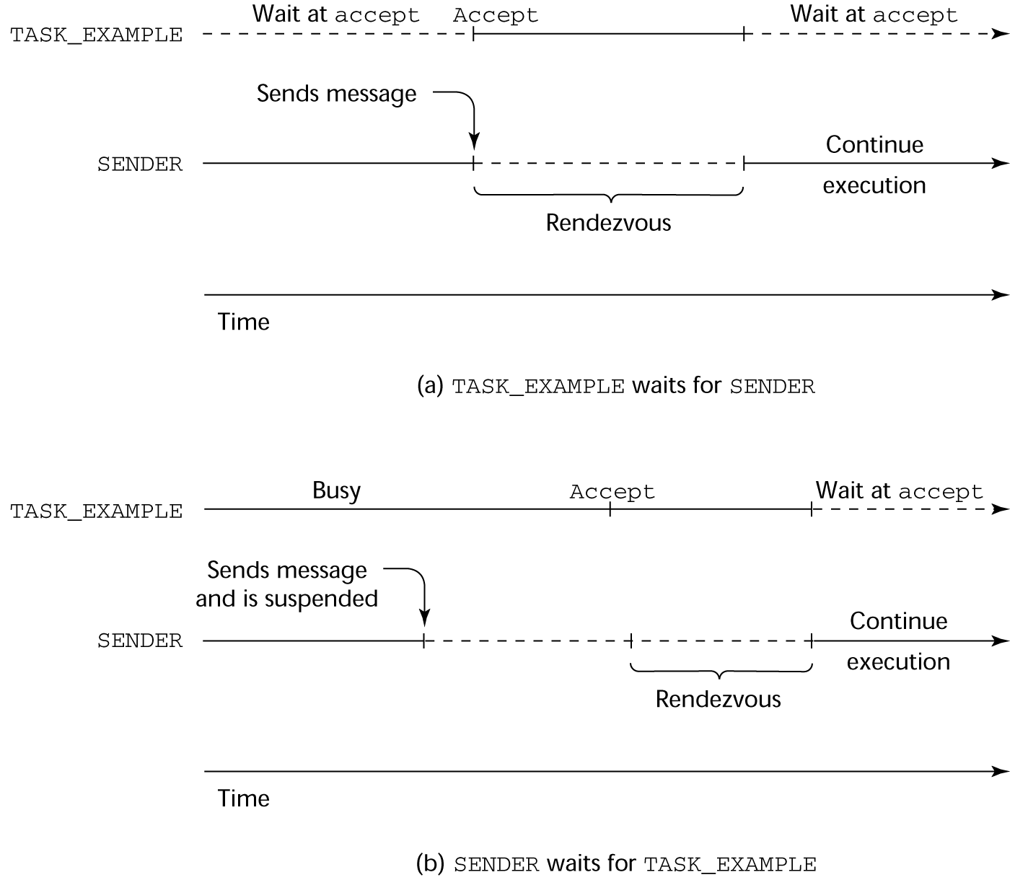
Task Communications

Slide 24
Java Threads
Java run method
A run method code can be in concurrent execution with other such methods
The process in which the run methods execute is called a thread
Syntactically thread is the concurrent unit supported by Java
To start a thread, a run method must be defined/inherited
Class myThread extends Thread
public void run () {…}
}
…
Thread myTh = new MyThread ();
myTh.start();

Slide 25
Java’s Thread Evaluation
Java’s support for concurrency is relatively simple but effective
Not as powerful as Ada’s tasks

Slide 26
Monitor in Java
class ManageBuf {
private int [100] buf;
public synchronized void deposit(…) { …}
public synchronized void fetch(…) {…}
…
}
Synchronized keyword: prevents from interfering with each other, i.e. support competition synchronization.
Thus, a ManageBuf object could serve as a monitor object.
Cooperation synchronization is provided via wait/notify methods (see example in next slide)

Slide 27
Consumer-Producer Example in Java
class producer extends Threads { …}
class consumer extends Threads { …}
class Queue {
…
public synchronized void deposit (…) { …
while (filled == queSize) wait();
que[NextItem] = item; …;
notifyall();
}
public synchronized void fetch() { …
while (filled==0) wait();
item=que[nextOut]; …;
notifyall();
}
}

Slide 28
C# Threads
Loosely based on Java but there are significant differences
Basic thread operations
Any method can run in its own thread
A thread is created by creating a Thread object
Creating a thread does not start its concurrent execution; it must be requested through the Start method
A thread can be made to wait for another thread to finish with Join
A thread can be suspended with Sleep
A thread can be terminated with Abort

Slide 29
Synchronizing Threads
Three ways to synchronize C# threads
The Interlocked class
Used when the only operations that need to be synchronized are incrementing or decrementing of an integer
The lock statement
Used to mark a critical section of code in a thread
lock (expression) {… }
The Monitor class
Provides four methods that can be used to provide more sophisticated synchronization

Slide 30
C#’s Concurrency Evaluation
An advance over Java threads, e.g., any method can run its own thread
Thread termination is cleaner than in Java
Synchronization is more sophisticated

Slide 31
Summary
Concurrent execution can be at the instruction, statement, or subprogram level
Physical concurrency: when multiple processors are used to execute concurrent units
Logical concurrency: concurrent united are executed on a single processor
Two primary facilities to support subprogram concurrency: competition synchronization and cooperation synchronization
Mechanisms: semaphores, monitors, rendezvous, threads

